Slide 1


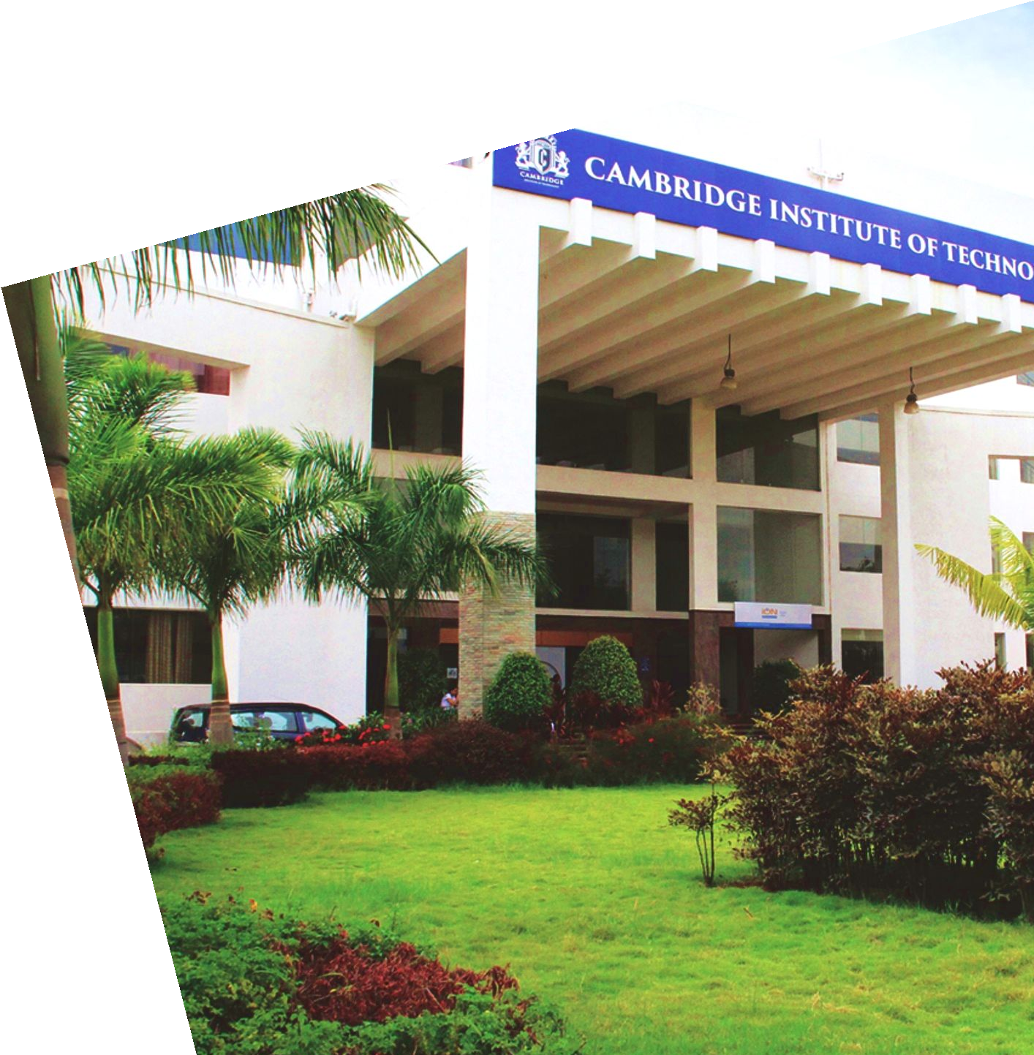
Project Title: AI Forecasting for Investor Decisions
Guided by: Dr. Preethi S, Professor and Head,
Dept of ISE, CIT
Presented by:
SHIVANNA (1CD21IS145)
RAVITEJA G.K (1CD21IS133)
SHAIK AFRAZ (1CD21IS139)
Notes:
Professor and Head,

Slide 2

Need for the Research
Collecting financial data – Use sources like Yahoo Finance, NSE, and Kaggle to get stock market data.
Cleaning and preparing data – Handle missing values, normalize prices, and select important features like moving averages, RSI, and volume trends
Choosing the best AI model – CNN, LSTM.
Training and testing models – Use past stock data to train AI and check its accuracy with metrics like RMSE.
Understanding financial rules – Learn about SEBI & SEC regulations to ensure our AI predictions follow financial laws.
Department of Information Science And Engineering
www.cambridge.edu.in

Slide 3
Abstract
Stock market prediction is a critical area of financial research, where accurate forecasts can significantly enhance investment strategies. This project explores neural networks to predict stock prices in the Indian stock market.
By understanding the security firms' market trends for forecasting future advice for the investors and investor behaviors. With the advancement of Artificial Intelligence (AI) such as Long short-term memory (LSTM) and convolutional neural network (CNN) for the prediction of stock market behavior to make investor decisions.
Department of Information Science And Engineering
www.cambridge.edu.in

Slide 4
Introduction
Stock market prediction is challenging due to market volatility and complexity.
Traditional methods rely on statistics and expert judgment but have limitations like bias and difficulty handling large data.
This research aims to develop a machine-learning model that analyzes historical data to predict stock prices accurately.
AI-driven models outperform traditional methods by identifying complex patterns, reducing human bias, and handling vast datasets efficiently.
This approach offers a more reliable and dynamic stock market prediction framework
Department of Information Science And Engineering
www.cambridge.edu.in

Slide 5
Objectives
Develop a robust machine-learning model for precise forecasting of stock prices.
Integrate real-time data analysis to enhance decision-making capabilities.
Bridge the gap between traditional statistical methods and advanced AI techniques.
Provide a scalable and adaptable forecasting system responsive to dynamic market conditions.
Department of Information Science And Engineering
www.cambridge.edu.in

Slide 6
Literature Review
Title and Author | Methodology used | Analysis
IoT-Based Smart | IoT-enabled smart | Promotes eco-
Waste | waste bins with | friendly habits,
Management | real-time level | optimizes waste
System with | indicators and | collection
Level Indicators | automatic | schedules, and
for Effective | segregation of | minimizes
Garbage Waste | waste. | environmental
Segregation |  | impact.
(Mary P.
Varghese et al.,
2024)
Uses moisture | Uses moisture and | Reduces fuel
and ultrasonic | ultrasonic sensors | consumption and
sensors for wet | for wet and dry | optimizes
and dry waste | waste segregation. | garbage pickup
segregation. | Implements an | time by ensuring
Implements an | improved routing | effective waste
improved routing | algorithm for | disposal.
algorithm for | efficient waste
efficient waste | collection.
collection.
Smart Waste Bin | Integrates Io T | Enhances real-
Management | sensors and | time decision-
System using IoT | machine learning | making and
and Machine | algorithms to | improves
Learning (Aazam | analyze waste | operational
M. et al.) | accumulation | efficiency by
 | patterns and | predicting waste
 | schedule pickups. | disposal needs.
Smart Waste | Uses ultrasonic | Improves
Collection System | sensors for real- | logistics by
Based on Io T | time garbage level | reducing
Sensors and | monitoring and | overflow
Cloud | cloud computing | incidents and
Computing | for route | optimizing
(Longhi S. et al., | optimization. | collection
2018) |  | efficiency.
Waste | Implements AI- | Enables better
Monitoring and | based predictive | scheduling of
Collection | analytics for waste | waste pickups,
Optimization | collection and | improving
Using Io T and | forecasting waste | resource
AI (Chen H. et | accumulation | management and
al., 2024) | trends. | reducing
 |  | unnecessary
 |  | collection trips.
Title and Author | Methodology used | Analysis
S. Singh and R. Mehta, "AI-Driven Stock Market Forecasting Using LSTM Models in the Indian Market," International Journal of Financial Engineering and Management, vol. 9, no. 2, pp.2022. | Singh and Mehta analyze LSTM models tailored for the Indian stock market, focusing on indices like NIFTY and SENSEX. Their research demonstrates the model's ability to predict price trends using historical data and technical indicators. | Evaluates model accuracy, identifies predictive strengths, and highlights financial market implications
A. Gupta and P. Sharma, "Sentiment Analysis and AI for Stock Prediction in India," Journal of Science Applications, vol. 7, no. 4, pp. 89-97, 2023. | Gupta and Sharma integrate sentiment analysis into stock price predictions. They analyze investor sentiment from news articles and social media platforms like Twitter to gauge market behavior. | Combines sentiment insights, enhances predictive accuracy, and interprets market reactions.
Department of Information Science And Engineering
www.cambridge.edu.in

Slide 7
Ramesh and D. Patel, "Hybrid Models Combining ARIMA and Neural Networks for Indian Stock Market Prediction," Indian Journal of Computational Intelligence, vol. 12, no. 1, pp.55-63,2023. | Ramesh and Patel present a hybrid model that integrates ARIMA (Auto-Regressive Integrated Moving Average) with neural networks to predict stock prices in the Indian stock market. | Integrates statistical and neural models, enhances prediction accuracy, and adapts to market trends
S. Nair and V. Krishnan, "AI in Stock Volatility Prediction: A Study on Indian Indices," International Journal of Financial Technology in India, vol. 5, no. 3, pp. 102-110, 2022. | Nair and Kumar focus on the importance of feature selection in improving the performance of AI models for stock market forecasting. | Optimizes feature selection, enhances model efficiency, and refines volatility predictions.
Department of Information Science And Engineering
www.cambridge.edu.in

Slide 8
Hardware Requirement
Title and Author | Methodology used | Analysis
IoT-Based Smart | IoT-enabled smart | Promotes eco-
Waste | waste bins with | friendly habits,
Management | real-time level | optimizes waste
System with | indicators and | collection
Level Indicators | automatic | schedules, and
for Effective | segregation of | minimizes
Garbage Waste | waste. | environmental
Segregation |  | impact.
(Mary P.
Varghese et al.,
2024)
Uses moisture | Uses moisture and | Reduces fuel
and ultrasonic | ultrasonic sensors | consumption and
sensors for wet | for wet and dry | optimizes
and dry waste | waste segregation. | garbage pickup
segregation. | Implements an | time by ensuring
Implements an | improved routing | effective waste
improved routing | algorithm for | disposal.
algorithm for | efficient waste
efficient waste | collection.
collection.
Smart Waste Bin | Integrates Io T | Enhances real-
Management | sensors and | time decision-
System using IoT | machine learning | making and
and Machine | algorithms to | improves
Learning (Aazam | analyze waste | operational
M. et al.) | accumulation | efficiency by
 | patterns and | predicting waste
 | schedule pickups. | disposal needs.
Smart Waste | Uses ultrasonic | Improves
Collection System | sensors for real- | logistics by
Based on Io T | time garbage level | reducing
Sensors and | monitoring and | overflow
Cloud | cloud computing | incidents and
Computing | for route | optimizing
(Longhi S. et al., | optimization. | collection
2018) |  | efficiency.
Waste | Implements AI- | Enables better
Monitoring and | based predictive | scheduling of
Collection | analytics for waste | waste pickups,
Optimization | collection and | improving
Using Io T and | forecasting waste | resource
AI (Chen H. et | accumulation | management and
al., 2024) | trends. | reducing
 |  | unnecessary
 |  | collection trips.
Development System
Processor: Intel Core i5/i7/i9 (10th generation or newer) or AMD Ryzen 5/7/9 series for efficient model training, dataset processing, and backend operations.
Ram: At least 8 GB (recommended 16 GB or more) to handle large stock datasets, model training, and Django server processes efficiently.
Storage: Solid-State Drive (SSD) with at least 256 GB for fast data access and improved application responsiveness. Additional storage might be needed for datasets, trained models, and logs.
GPU (Optional but Recommended): NVIDIA GTX 1660 Ti or higher for faster model training and prediction tasks.
Department of Information Science And Engineering
www.cambridge.edu.in

Slide 9
Software Requirement
Title and Author | Methodology used | Analysis
IoT-Based Smart | IoT-enabled smart | Promotes eco-
Waste | waste bins with | friendly habits,
Management | real-time level | optimizes waste
System with | indicators and | collection
Level Indicators | automatic | schedules, and
for Effective | segregation of | minimizes
Garbage Waste | waste. | environmental
Segregation |  | impact.
(Mary P.
Varghese et al.,
2024)
Uses moisture | Uses moisture and | Reduces fuel
and ultrasonic | ultrasonic sensors | consumption and
sensors for wet | for wet and dry | optimizes
and dry waste | waste segregation. | garbage pickup
segregation. | Implements an | time by ensuring
Implements an | improved routing | effective waste
improved routing | algorithm for | disposal.
algorithm for | efficient waste
efficient waste | collection.
collection.
Smart Waste Bin | Integrates Io T | Enhances real-
Management | sensors and | time decision-
System using IoT | machine learning | making and
and Machine | algorithms to | improves
Learning (Aazam | analyze waste | operational
M. et al.) | accumulation | efficiency by
 | patterns and | predicting waste
 | schedule pickups. | disposal needs.
Smart Waste | Uses ultrasonic | Improves
Collection System | sensors for real- | logistics by
Based on Io T | time garbage level | reducing
Sensors and | monitoring and | overflow
Cloud | cloud computing | incidents and
Computing | for route | optimizing
(Longhi S. et al., | optimization. | collection
2018) |  | efficiency.
Waste | Implements AI- | Enables better
Monitoring and | based predictive | scheduling of
Collection | analytics for waste | waste pickups,
Optimization | collection and | improving
Using Io T and | forecasting waste | resource
AI (Chen H. et | accumulation | management and
al., 2024) | trends. | reducing
 |  | unnecessary
 |  | collection trips.
Operating System: Linux (Ubuntu 20.04 LTS or later) for seamless compatibility with TensorFlow, Django, and Python libraries. Windows 10/11 (with WSL2 support) for a Linux-based development environment.
Web Framework: Django (latest stable version) for backend development.
Frontend Technologies: HTML5, CSS3, and JavaScript for building responsive and intuitive user interfaces.
Machine Learning Frameworks and Libraries: TensorFlow (2.x) – For building and deploying the CNN-LSTM model.
Version Control: GitHub– For collaboration and deployment pipelines.
Database: SQLite (Development Stage) – Lightweight and easy to configure for local development.
Department of Information Science And Engineering
www.cambridge.edu.in
Notes:
• scikit-learn – For preprocessing and performance evaluation.
• NumPy – Numerical computations and data manipulation.
• Pandas – Data analysis and dataset handling.
• Matplotlib – Data visualization for insights and predictions
Version Control:
GitHub– For collaboration and deployment pipelines

Slide 10
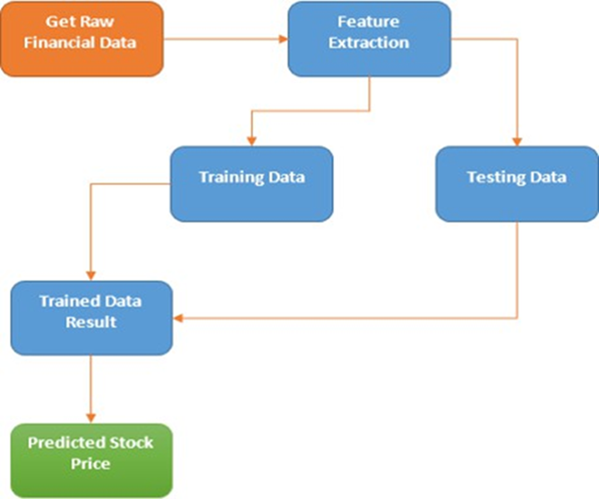
Methodology
Title and Author | Methodology used | Analysis
IoT-Based Smart | IoT-enabled smart | Promotes eco-
Waste | waste bins with | friendly habits,
Management | real-time level | optimizes waste
System with | indicators and | collection
Level Indicators | automatic | schedules, and
for Effective | segregation of | minimizes
Garbage Waste | waste. | environmental
Segregation |  | impact.
(Mary P.
Varghese et al.,
2024)
Uses moisture | Uses moisture and | Reduces fuel
and ultrasonic | ultrasonic sensors | consumption and
sensors for wet | for wet and dry | optimizes
and dry waste | waste segregation. | garbage pickup
segregation. | Implements an | time by ensuring
Implements an | improved routing | effective waste
improved routing | algorithm for | disposal.
algorithm for | efficient waste
efficient waste | collection.
collection.
Smart Waste Bin | Integrates Io T | Enhances real-
Management | sensors and | time decision-
System using IoT | machine learning | making and
and Machine | algorithms to | improves
Learning (Aazam | analyze waste | operational
M. et al.) | accumulation | efficiency by
 | patterns and | predicting waste
 | schedule pickups. | disposal needs.
Smart Waste | Uses ultrasonic | Improves
Collection System | sensors for real- | logistics by
Based on Io T | time garbage level | reducing
Sensors and | monitoring and | overflow
Cloud | cloud computing | incidents and
Computing | for route | optimizing
(Longhi S. et al., | optimization. | collection
2018) |  | efficiency.
Waste | Implements AI- | Enables better
Monitoring and | based predictive | scheduling of
Collection | analytics for waste | waste pickups,
Optimization | collection and | improving
Using Io T and | forecasting waste | resource
AI (Chen H. et | accumulation | management and
al., 2024) | trends. | reducing
 |  | unnecessary
 |  | collection trips.
System Architecture
Three main modules:
Input Module: Collects historical stock data and market indicators.
Processing Module: Uses LSTM and CNN.
Output Module: Displays predicted prices and trends.
Working Mechanism
Historical and real-time stock data is collected.
Machine learning models analyze trends and patterns.
Predictions for future stock prices are generated.
Results are displayed on a dashboard with visual insights.
Investors use predictions for informed decision-making.
Department of Information Science And Engineering
www.cambridge.edu.in

Slide 11
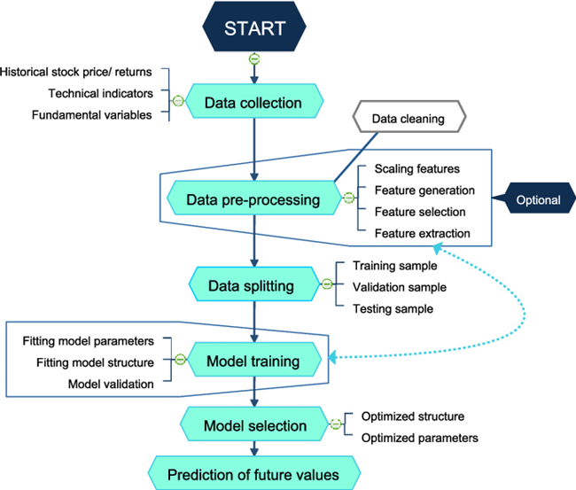

Flow diagram
Title and Author | Methodology used | Analysis
IoT-Based Smart | IoT-enabled smart | Promotes eco-
Waste | waste bins with | friendly habits,
Management | real-time level | optimizes waste
System with | indicators and | collection
Level Indicators | automatic | schedules, and
for Effective | segregation of | minimizes
Garbage Waste | waste. | environmental
Segregation |  | impact.
(Mary P.
Varghese et al.,
2024)
Uses moisture | Uses moisture and | Reduces fuel
and ultrasonic | ultrasonic sensors | consumption and
sensors for wet | for wet and dry | optimizes
and dry waste | waste segregation. | garbage pickup
segregation. | Implements an | time by ensuring
Implements an | improved routing | effective waste
improved routing | algorithm for | disposal.
algorithm for | efficient waste
efficient waste | collection.
collection.
Smart Waste Bin | Integrates Io T | Enhances real-
Management | sensors and | time decision-
System using IoT | machine learning | making and
and Machine | algorithms to | improves
Learning (Aazam | analyze waste | operational
M. et al.) | accumulation | efficiency by
 | patterns and | predicting waste
 | schedule pickups. | disposal needs.
Smart Waste | Uses ultrasonic | Improves
Collection System | sensors for real- | logistics by
Based on Io T | time garbage level | reducing
Sensors and | monitoring and | overflow
Cloud | cloud computing | incidents and
Computing | for route | optimizing
(Longhi S. et al., | optimization. | collection
2018) |  | efficiency.
Waste | Implements AI- | Enables better
Monitoring and | based predictive | scheduling of
Collection | analytics for waste | waste pickups,
Optimization | collection and | improving
Using Io T and | forecasting waste | resource
AI (Chen H. et | accumulation | management and
al., 2024) | trends. | reducing
 |  | unnecessary
 |  | collection trips.
Department of Information Science And Engineering
www.cambridge.edu.in

Slide 12
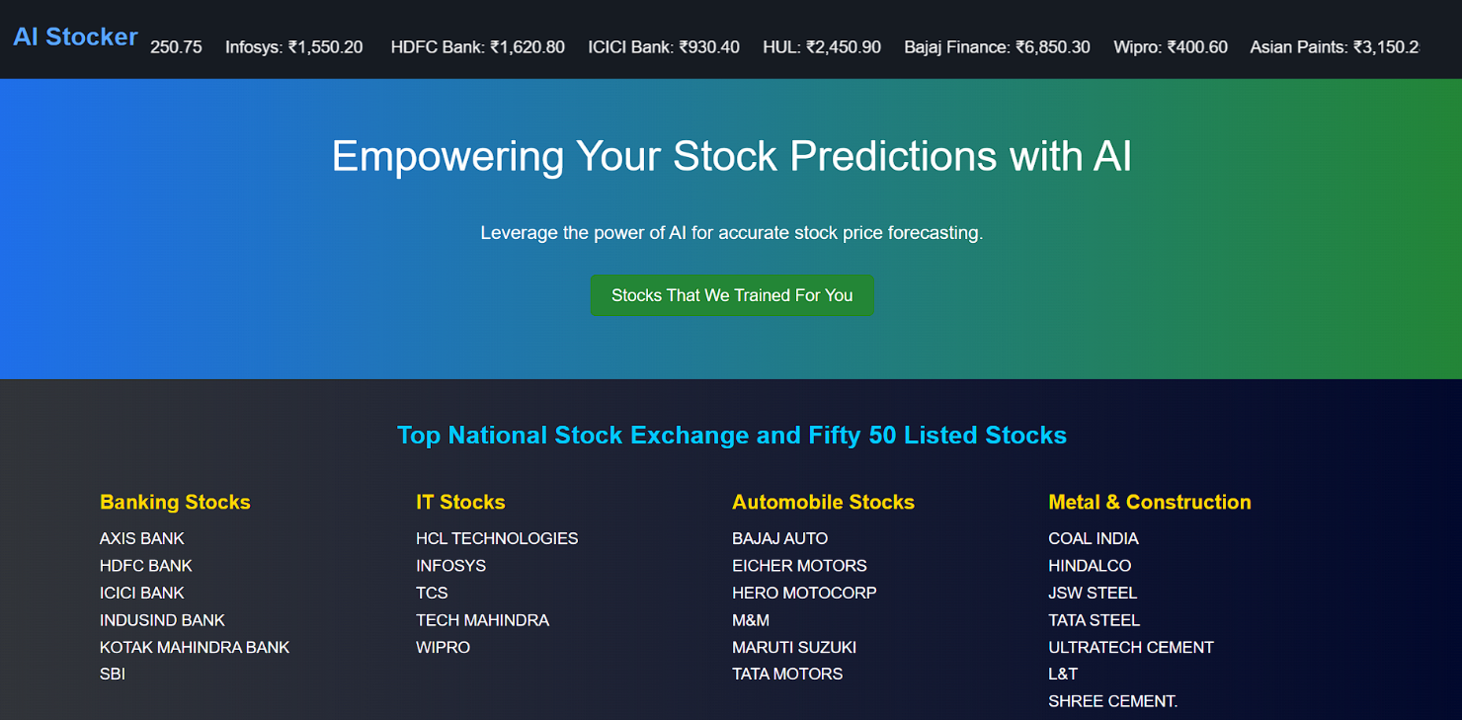
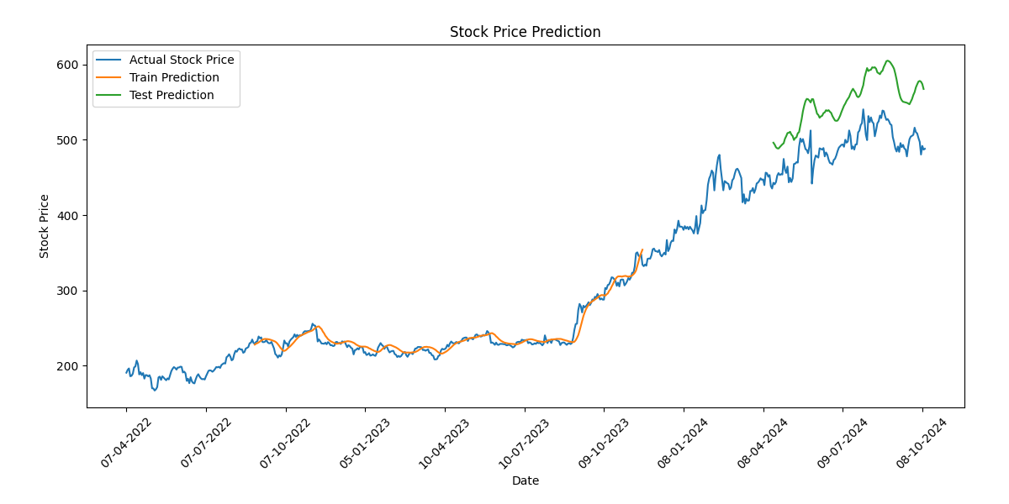
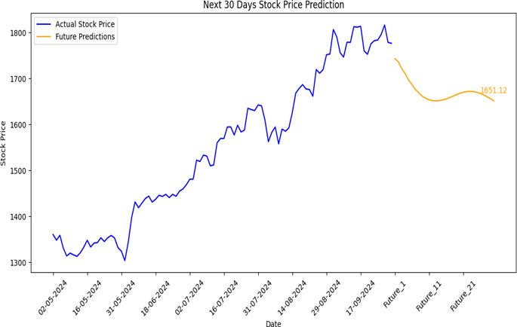
Results
Title and Author | Methodology used | Analysis
IoT-Based Smart | IoT-enabled smart | Promotes eco-
Waste | waste bins with | friendly habits,
Management | real-time level | optimizes waste
System with | indicators and | collection
Level Indicators | automatic | schedules, and
for Effective | segregation of | minimizes
Garbage Waste | waste. | environmental
Segregation |  | impact.
(Mary P.
Varghese et al.,
2024)
Uses moisture | Uses moisture and | Reduces fuel
and ultrasonic | ultrasonic sensors | consumption and
sensors for wet | for wet and dry | optimizes
and dry waste | waste segregation. | garbage pickup
segregation. | Implements an | time by ensuring
Implements an | improved routing | effective waste
improved routing | algorithm for | disposal.
algorithm for | efficient waste
efficient waste | collection.
collection.
Smart Waste Bin | Integrates Io T | Enhances real-
Management | sensors and | time decision-
System using IoT | machine learning | making and
and Machine | algorithms to | improves
Learning (Aazam | analyze waste | operational
M. et al.) | accumulation | efficiency by
 | patterns and | predicting waste
 | schedule pickups. | disposal needs.
Smart Waste | Uses ultrasonic | Improves
Collection System | sensors for real- | logistics by
Based on Io T | time garbage level | reducing
Sensors and | monitoring and | overflow
Cloud | cloud computing | incidents and
Computing | for route | optimizing
(Longhi S. et al., | optimization. | collection
2018) |  | efficiency.
Waste | Implements AI- | Enables better
Monitoring and | based predictive | scheduling of
Collection | analytics for waste | waste pickups,
Optimization | collection and | improving
Using Io T and | forecasting waste | resource
AI (Chen H. et | accumulation | management and
al., 2024) | trends. | reducing
 |  | unnecessary
 |  | collection trips.
Department of Information Science And Engineering
www.cambridge.edu.in
Notes:
The implementation of AI in stock market forecasting has transformed the way investors analyze and interpret market trends. This project has explored how machine learning algorithms, including regression models, neural networks, and deep learning techniques, can process vast amounts of historical and real-time data to generate accurate stock price predictions. By leveraging these advanced computational methods, AI helps mitigate human biases, improves decision-making, and provides traders with valuable insights into market movements.
Achieved high accuracy in predicting stock prices using ML models like LSTM, ARIMA, and Random Forest.
Generated insightful graphs for trend analysis and pattern.
Evaluated multiple ML models to determine the best-performing algorithm for different market conditions.

Slide 13
Conclusion
The implementation of AI in stock market forecasting has transformed the way investors analyze and interpret market trends. This project has explored how machine learning algorithms, including regression models, neural networks, and deep learning techniques, can process vast amounts of historical and real-time data to generate accurate stock price predictions. By leveraging these advanced computational methods, AI helps mitigate human biases, improves decision-making, and provides traders with valuable insights into market movements.
Looking ahead, AI in stock market prediction is expected to evolve further with advancements in reinforcement learning, sentiment analysis, and quantum computing. Integrating real-time trading platforms, improving feature selection techniques, and refining deep learning architectures will enhance the predictive capabilities of AI models. As technology progresses, AI-driven financial forecasting will continue to shape investment strategies, offering investors more sophisticated and data-driven approaches to navigating the complexities of the stock market.
Department of Information Science And Engineering
www.cambridge.edu.in

Slide 14
References
Nayak, A., Pai, M. M. M., & Pai, R. M. (2021). Prediction Models for Indian Stock Market. SSRN.
Chauhan, A., Mayur, P., Gokarakonda, Y. S., Jamie, P., & Mehrotra, N. (2024). Indian Stock Market Prediction using Augmented Financial Intelligence ML. arXiv preprint arXiv:2407.02236.
Sen, J., Waghela, H., & Rakshit, S. (2024). Exploring Sectoral Profitability in the Indian Stock Market Using Deep Learning. arXiv preprint arXiv:2407.01572.
Sen, J., & Mehtab, S. (2021). Design and Analysis of Robust Deep Learning Models for Stock Price Prediction. arXiv preprint arXiv:2106.09664.
Bhunia, A. (2025). Impact of Artificial Intelligence on Stock Price Prediction in India. Journal of Finance and Accounting, 13(1), 1-6.
Department of Information Science And Engineering
www.cambridge.edu.in

Slide 15



Patel, J., Shah, S., Thakkar, P., & Kotecha, K. (2015). Predicting Stock Market Index Using Fusion of Machine Learning Techniques. Expert Systems with Applications, 42(4), 2162-2172.
Jain, R., & Dandapat, S. (2019). A Machine Learning Approach for Stock Price Prediction: A Study on the Indian Stock Market. Procedia Computer Science, 167, 26-35.
Mehta, S., & Sharma, A. (2020). Artificial Neural Networks for Predicting Stock Prices in Indian Market. Indian Journal of Finance, 14(6), 35-48.
Chopra, A., & Sharma, R. (2021). A Study of Role of Artificial Intelligence in Stock Market Prediction. International Journal of Novel Research and Development, 9(5), 56-60.
Choudhary, S., & Garg, N. (2022). AI and Financial Markets: Opportunities and Challenges in India. Indian Journal of Finance, 16(5), 25-40.
Department of Information Science And Engineering www.cambridge.edu.in

Slide 16
Thank you

